Slide 1
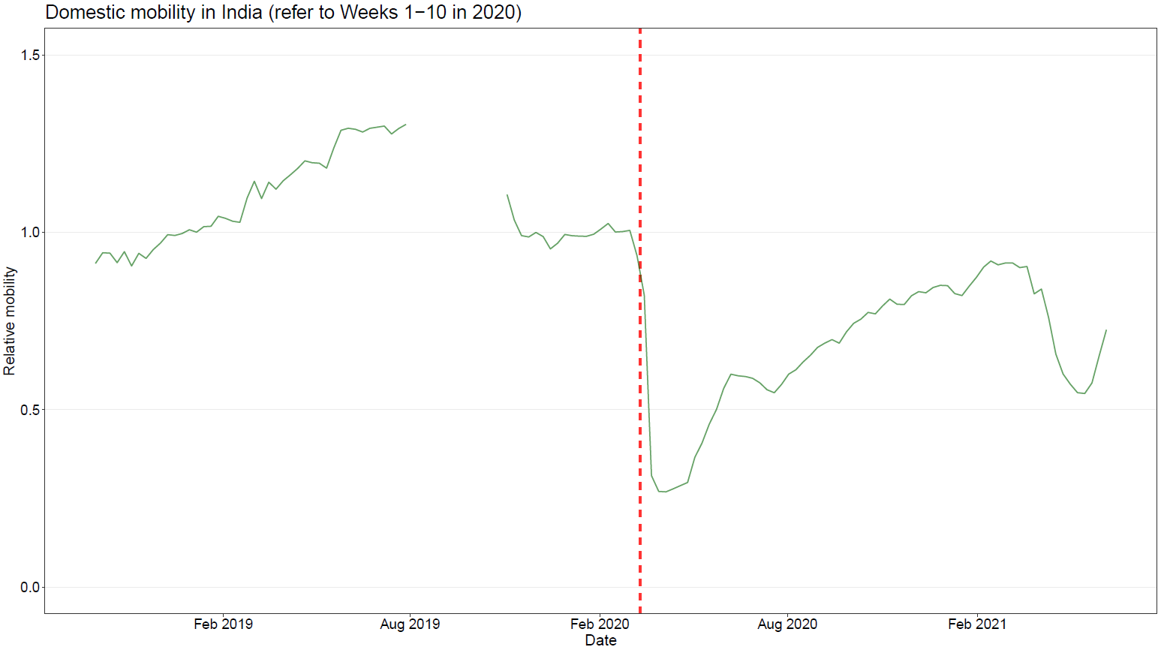
Period 1: 30/09/2018-03/08/2019 (data in 2018- summer 2019)
Period 2: 03/11/2019-21/03/2020 (before pandemic)
Period 3: 22/03/2020-23/05/2020 (lockdown during 1st wave)
Period 4: 24/05/2020-31/10/2020 (recovery from 1st wave)
Period 5: 01/11/2020-17/04/2021 (before Delta wave)
Period 6: 18/04/2021-12/06/2021 (during Delta lockdown)

Slide 2
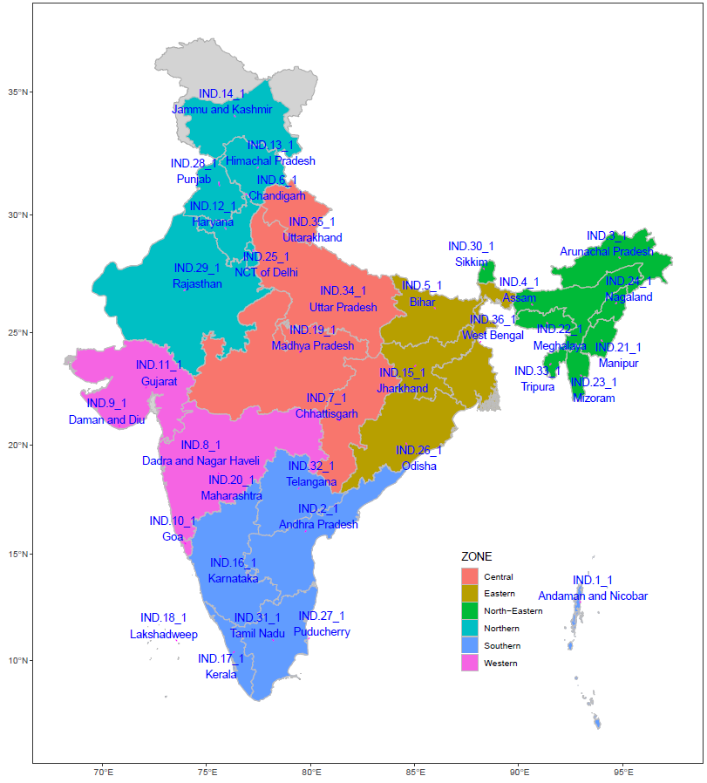
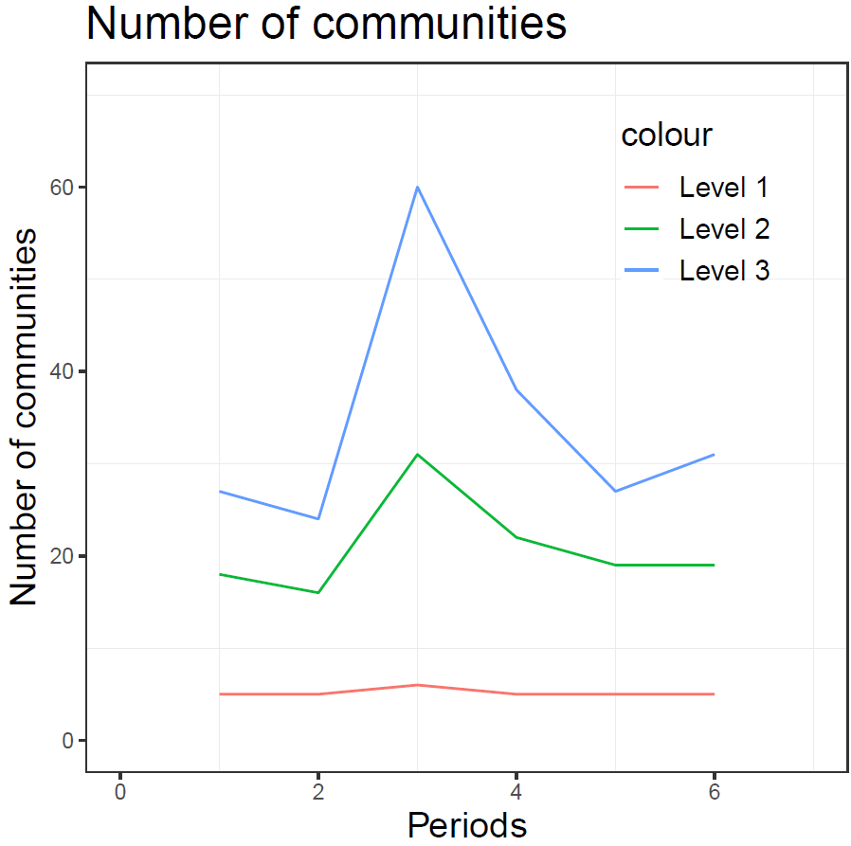

Slide 3
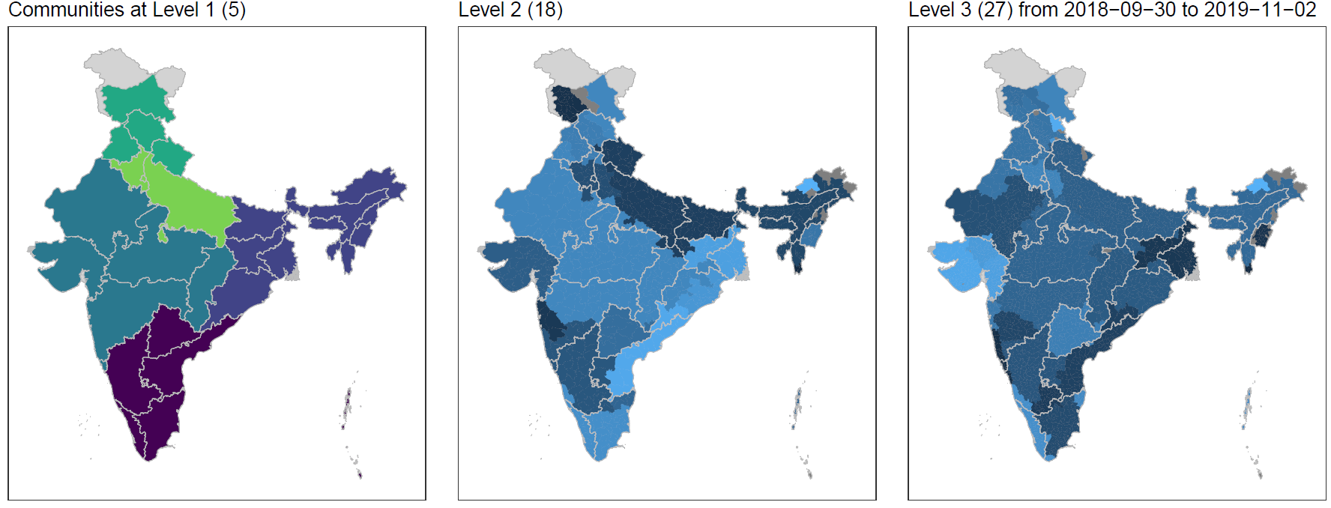

Slide 4
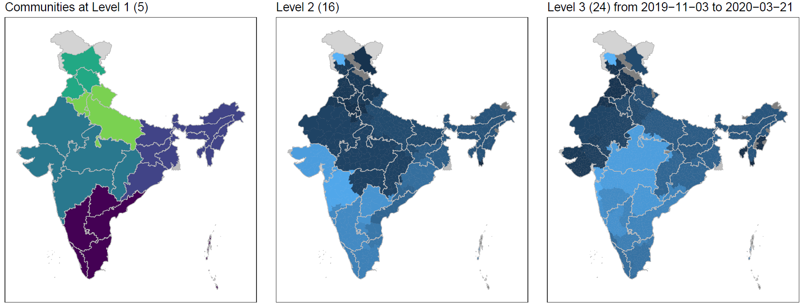

Slide 5
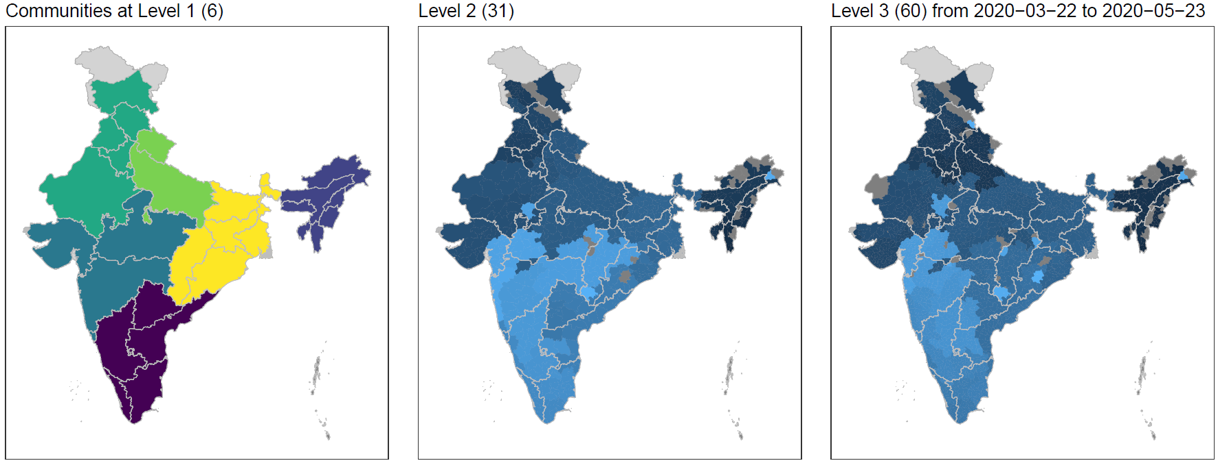

Slide 6
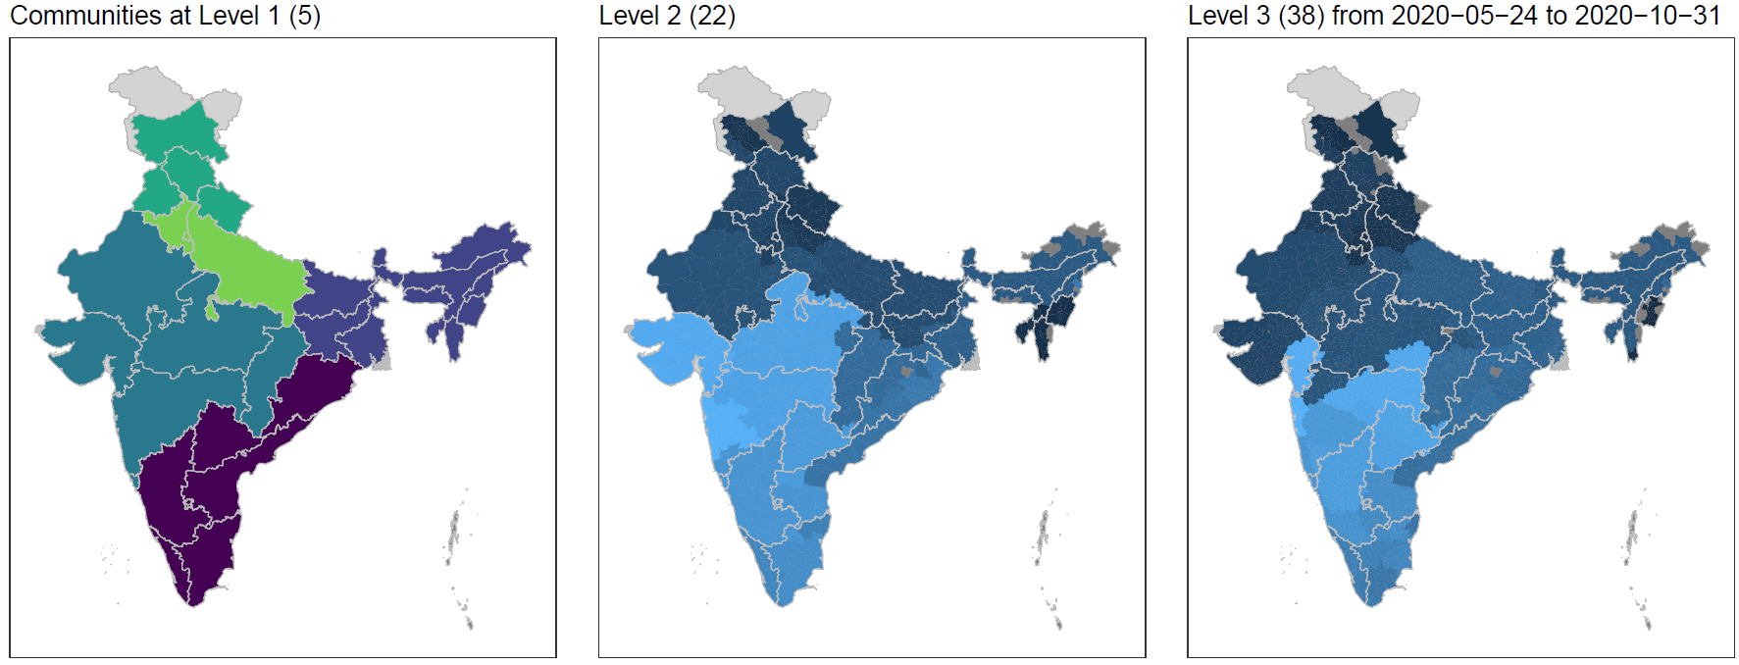

Slide 7
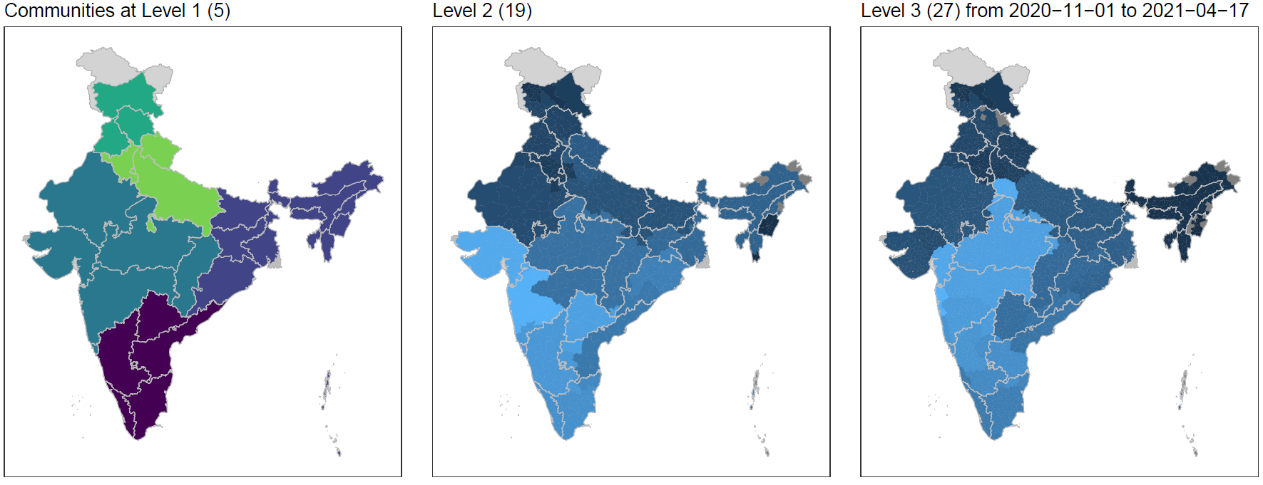

Slide 8
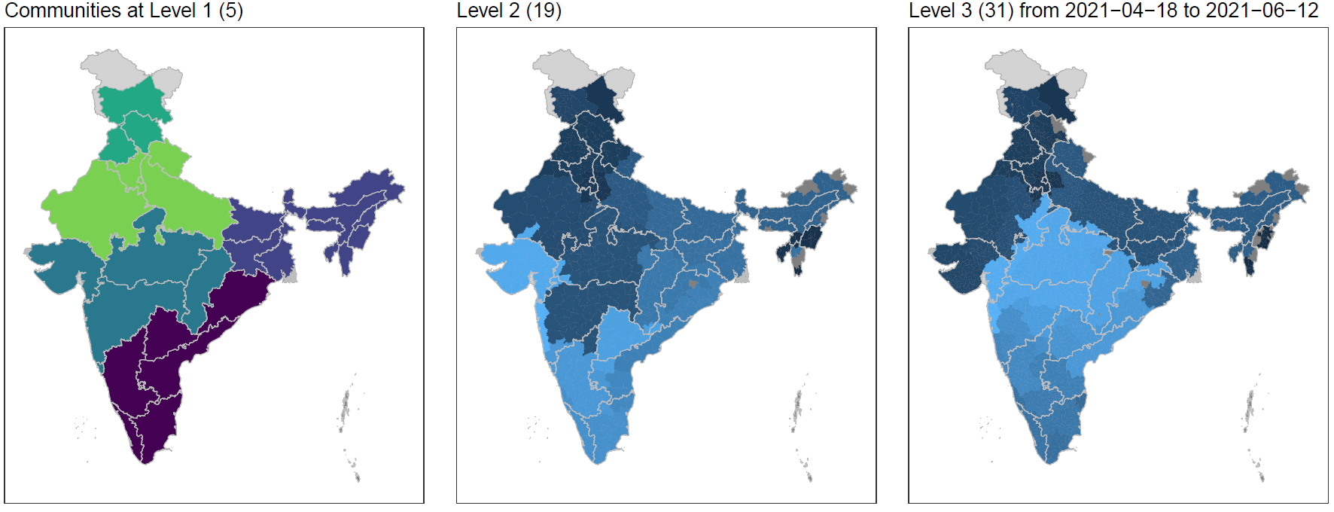

Slide 9
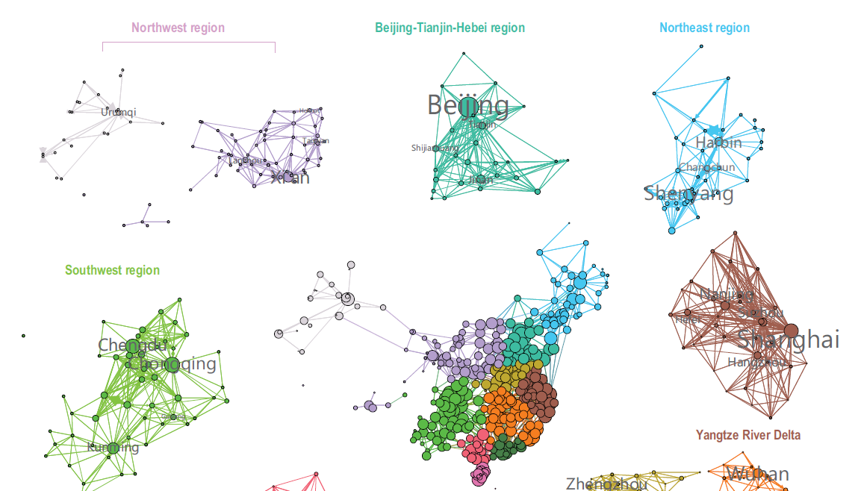
Next steps
Visualisation of the changed community structure at level 2/3

Slide 10
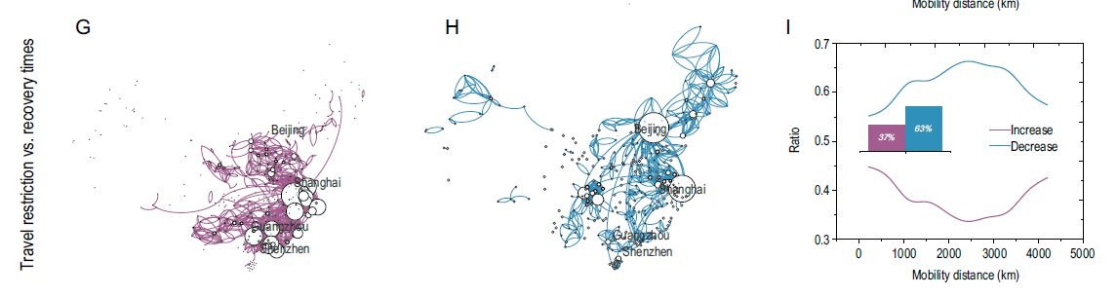
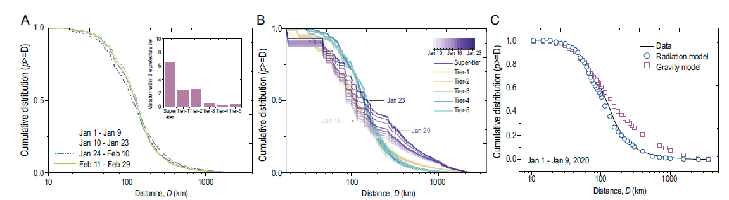
Next steps
Comparison of spatial patterns of mobility across periods and rural/urban areas
Modelling

